Slide 1
Cardinal O’Connell
Early Learning Center
Virtual Open House
Lisa Van Thiel, Early Childhood Coordinator & Principal
Jennifer Williams, Social Worker

Slide 2
Packet mailed includes:
Welcome Letter
Emergency Form
Family Survey
Nurse form
School Calendar
Let us now if you do not receive in the mail. All form are posted on our website and can be downloaded

Slide 3
Open House
CSA – August 28, 2023 – 2:30-3:30 PM
All other students – August 30, 10-11 AM or 1:00 -2:00 PM
First day of school is September 5, 2023
At the open house your will receive a
Welcome packet
Invite you to CLASS DoJo via email Lisa and Jennifer
Teachers will provide their own welcome letter and invite to DoJo
Meet the teachers and see classroom

Slide 4
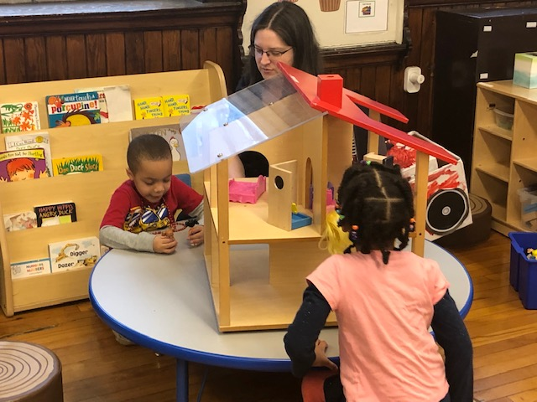
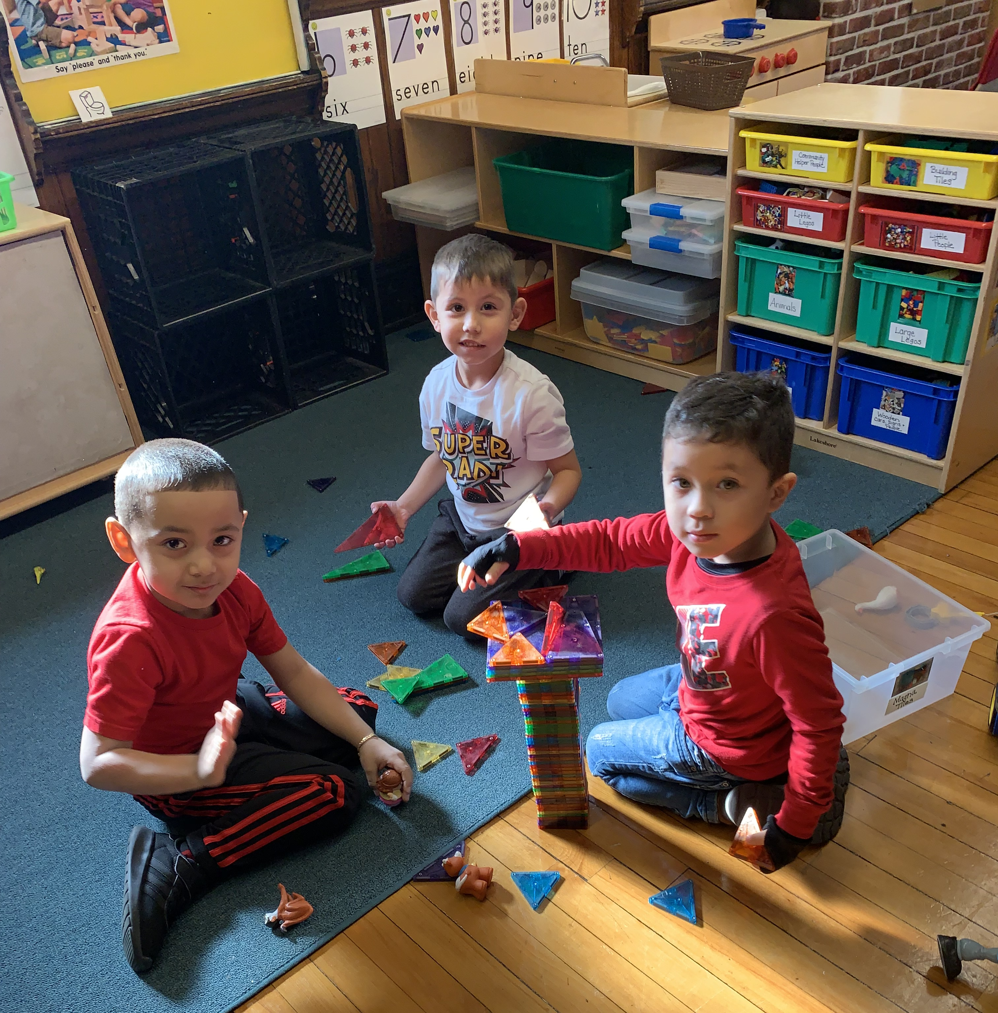
Preschool Curriculum
Seven theme curriculum modules and linked DESE Standards
Book reading
Vocabulary building
Opportunities to play while building math, language and literacy skills
Building Blocks – math program
Handwriting without Tears – learn how to write letters
Heggerty phonemic awareness (songs letter play)
Second Steps – Social Emotional Curriculum
Notes:
Seven curriculum units: Ready to Learn – focus learning about school, routines rules and how to be with others.
Module 1 All about Me – learning about are selves and our senses and how they help us learn
Module 2 Family and Community
Module 3 – We all live somewhere – homes people and animals and traditions
Module 4 We all have ideas – creativity – tool machines and construction are used to talk and explore design and to make plans before action
Module 5 Growing and Changing – life cycles people, plants and other reoccurring cycles
Module 6 Exploring are Earth – ocean, land and water – recycling

Slide 5
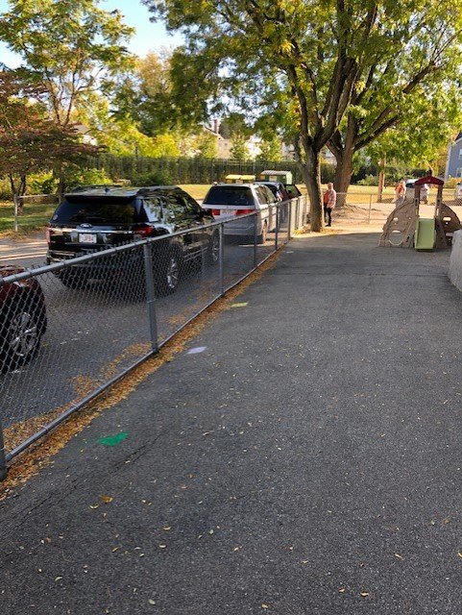
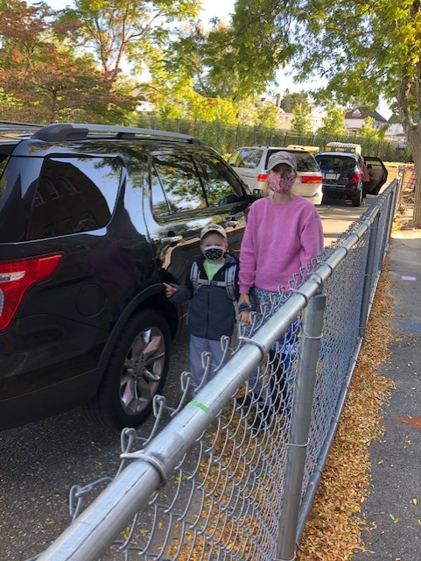
Drop off and pick up
Notes:
Buses park in the front of the building. Please do not park in front of the school or at the corner of Livingston and Carter. Children are drop off on Carter Ave.
Please unload your child and bring them to the closest gate. We have two gates so 6 families can load and unload at a time. If your car is not full on Carter Ave we ask that you remain in your car and wait to be waived to the front of the line.

Slide 6
Drop off, Pick up and Parking

Slide 7
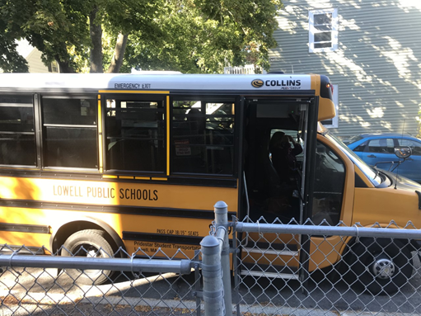
Buses
Notes:
Families should have received bus information. If you have not yet received it please call the office and we will make sure you have the information need prior to the start of school. Transportation is not provide unless a child has an IEP.

Slide 8
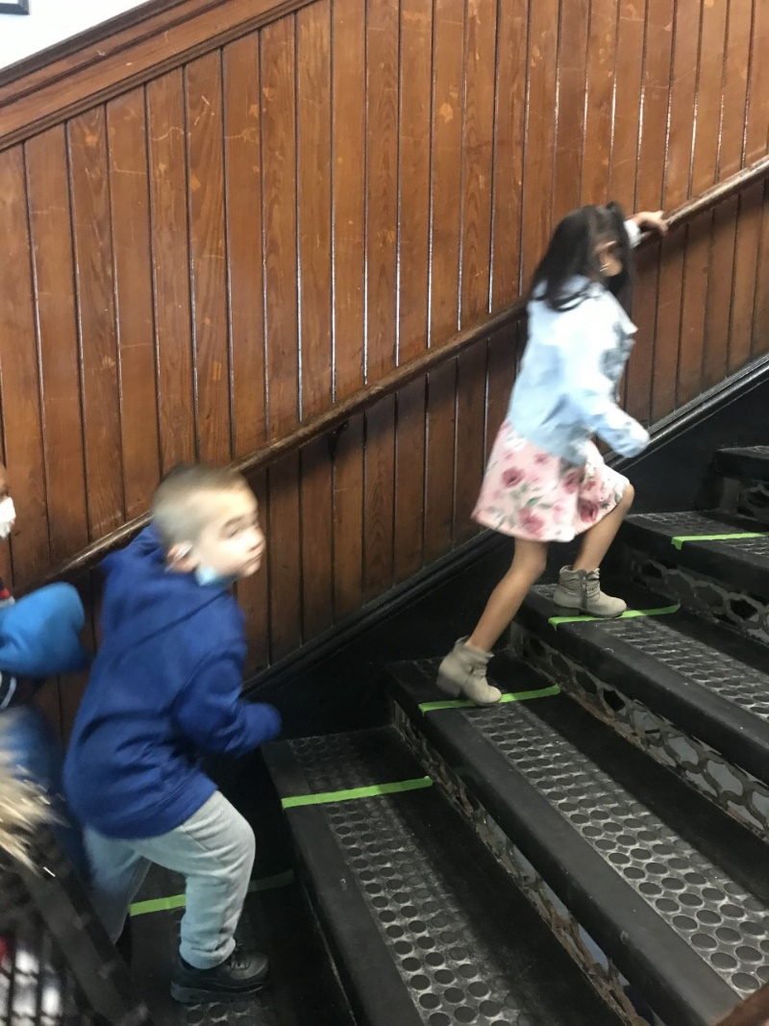
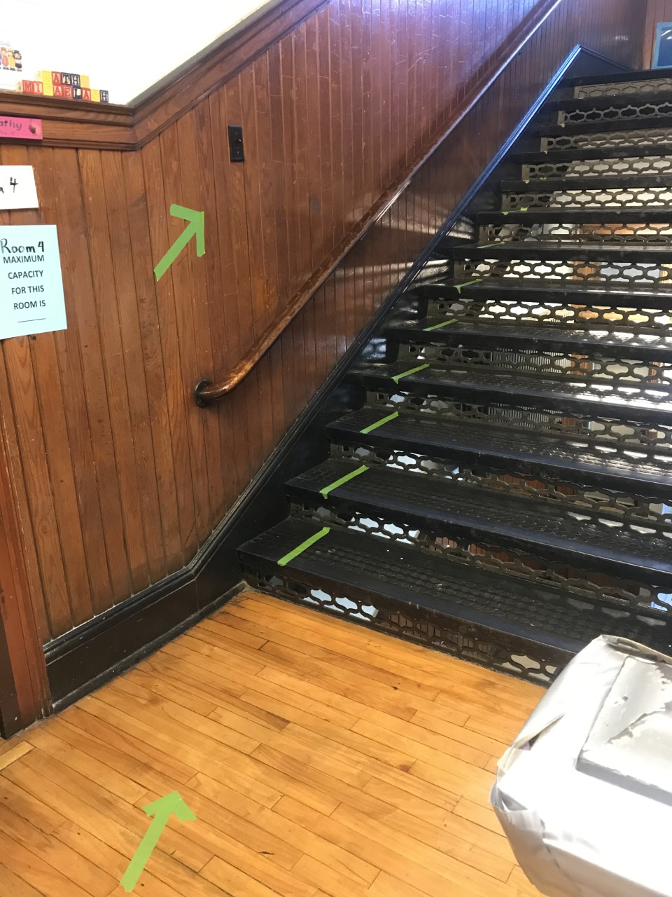
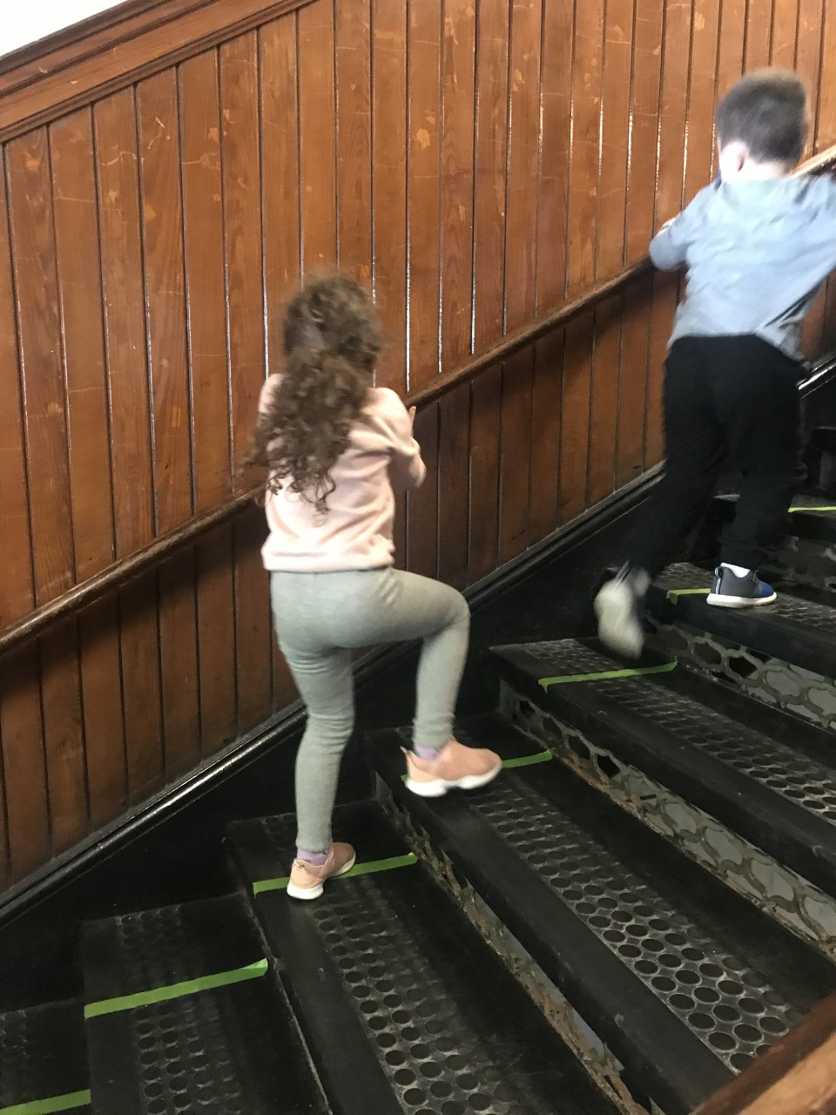
Arrival Going Up….
Notes:
We have two stairwell – we are using one set to go up and the other to go down and will continue to limit having multiple group in the hall-way together.

Slide 9
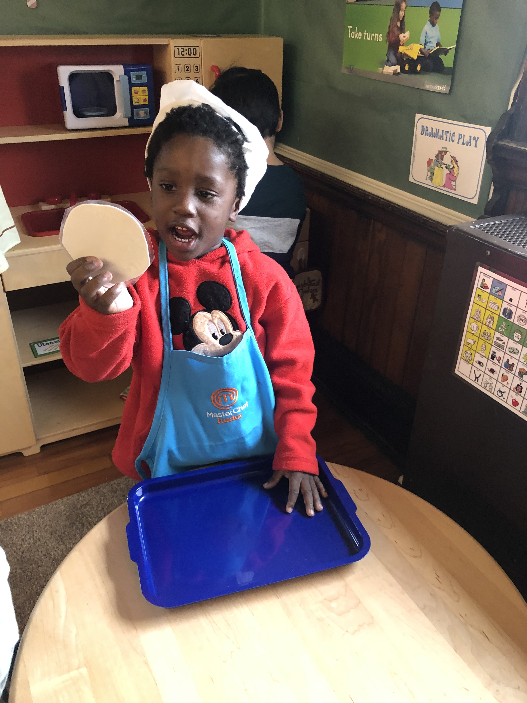
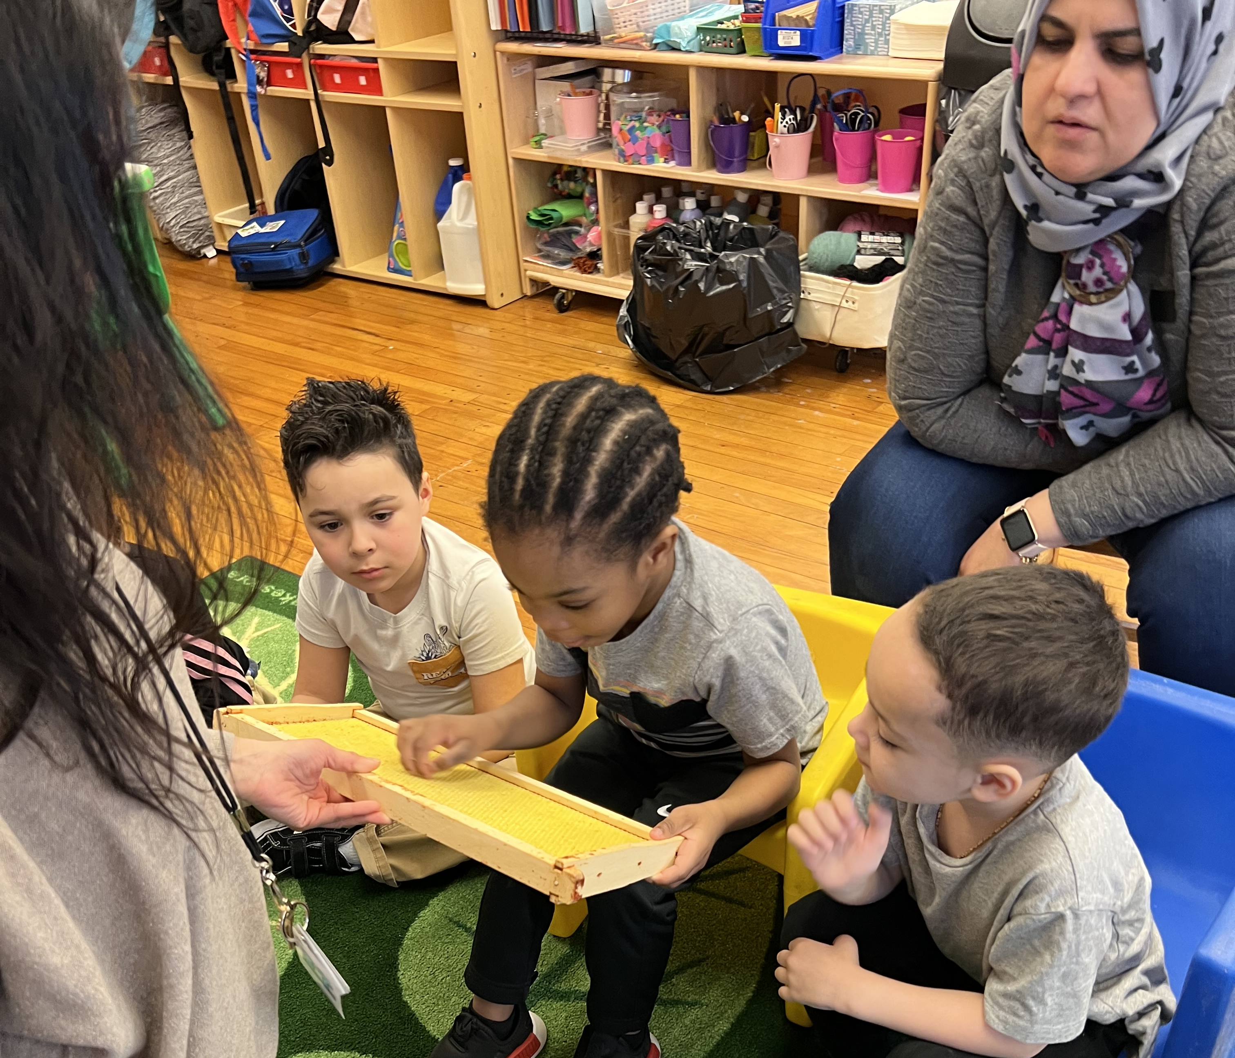
Preparing the environment

Slide 10
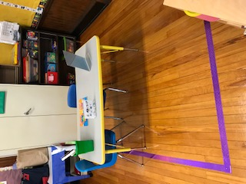
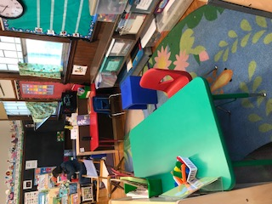
Intentionally design classrooms

Slide 11
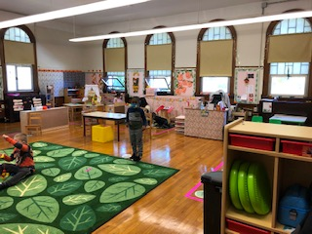
Center time opportunity to practice new skills
Notes:
As you can see we do are best to maintain three feet distance between students when possible and have created traffic patterns and bath room schedule to avoid groups from cross contamination.
Lunches are served in classrooms and there is assigned seating for meals.
One of the routines we have added during covid is the wash, play, and switch center routine for shared materials.

Slide 12
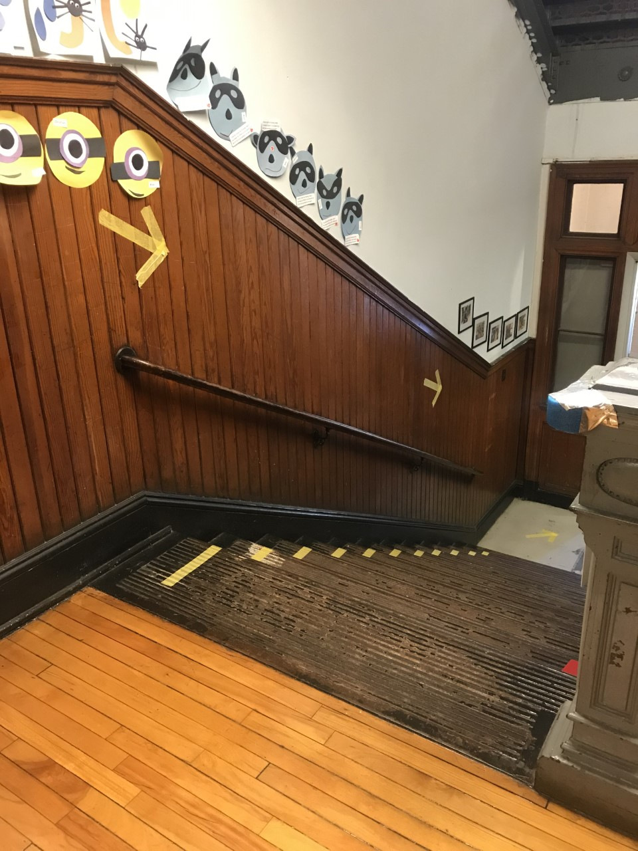
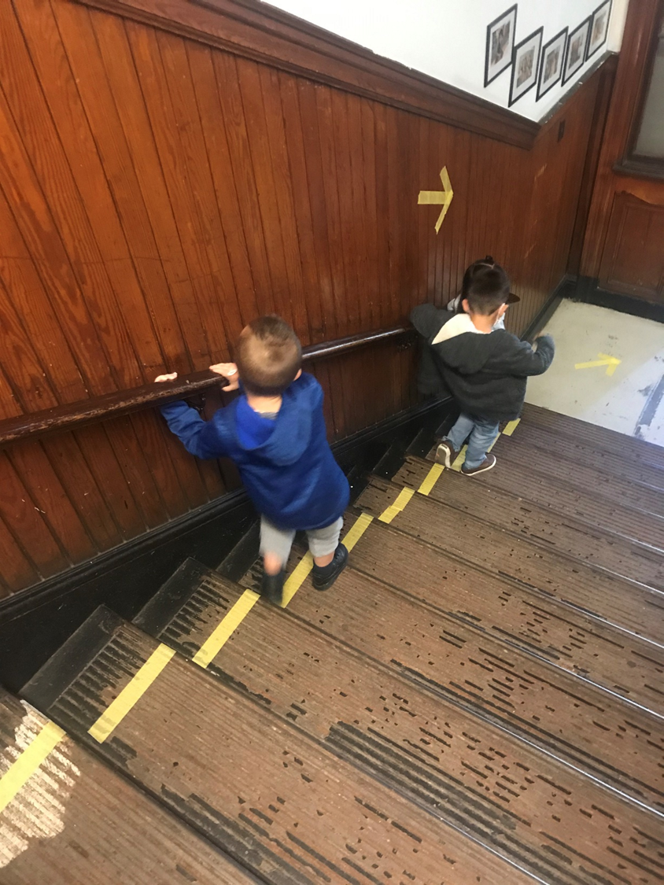
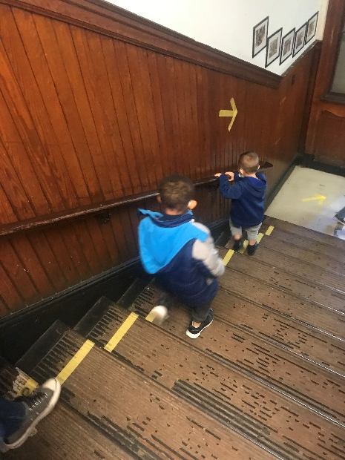
Down …..

Slide 13
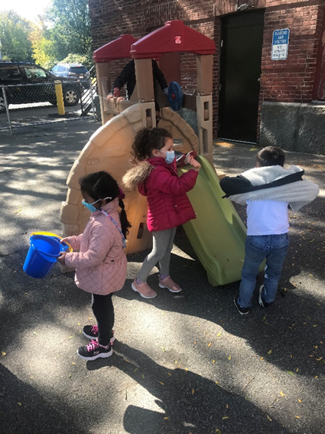
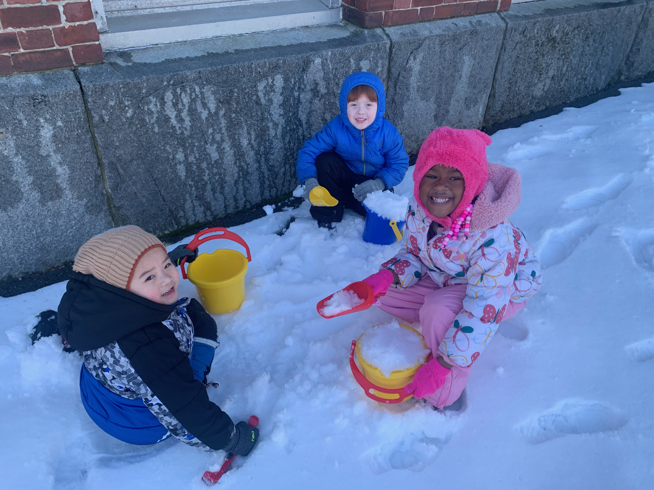
And Out…..

Slide 14
Sample Preschool Schedules
Half – Day Schedule | Full-Day Schedule
Breakfast/lunch 20 minutes First Circle – Dialogic Reading 20 minutes Introduction to Centers 60 minutes Small group Second Circle – Science, Social and Emotional Learning, and Songs Words and Letter Play 20minutes Bathroom 10 minutes Outside 20 minutes | Breakfast - 30 minutes First Circle – 20 minutes Center Time – 60 minutes Outdoor play – 30 minutes Small groups – 30 minutes Bathroom – 10 minutes Lunch 30 minutes Rest 50 minutes Second Circle 20 minutes Second Centers 40 minutes Bathroom 10 minutes Outdoor 30 minutes

Slide 15
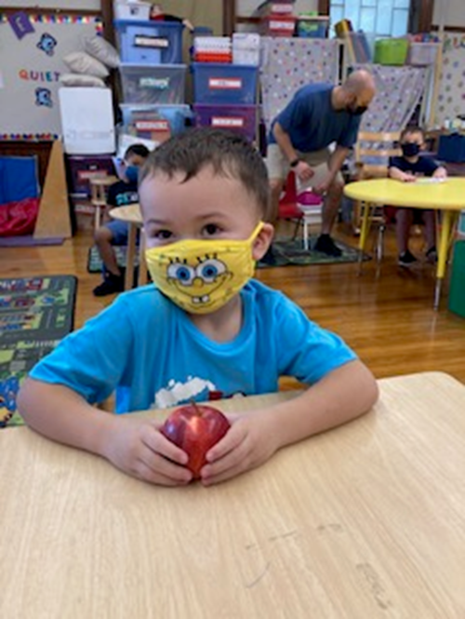
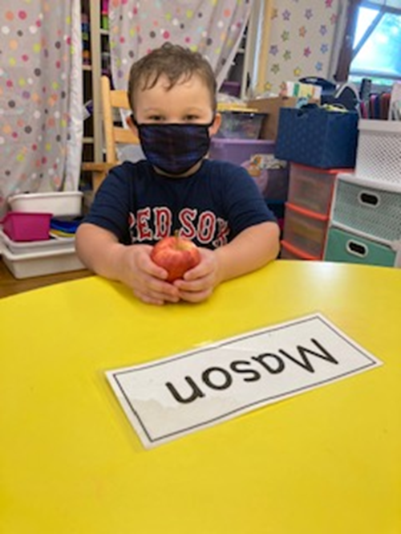
Masking Wearing (Not an issue)

Slide 16
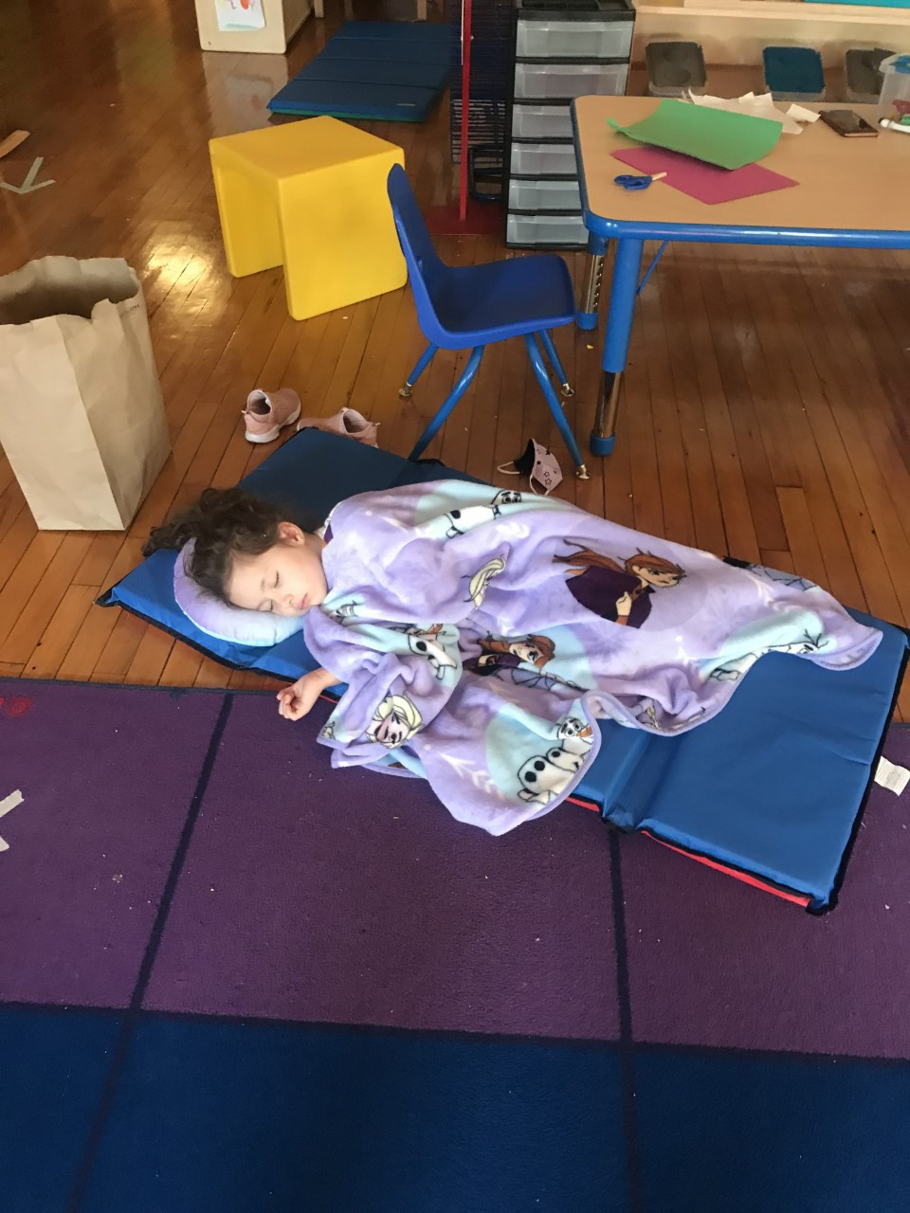
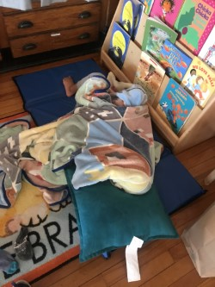
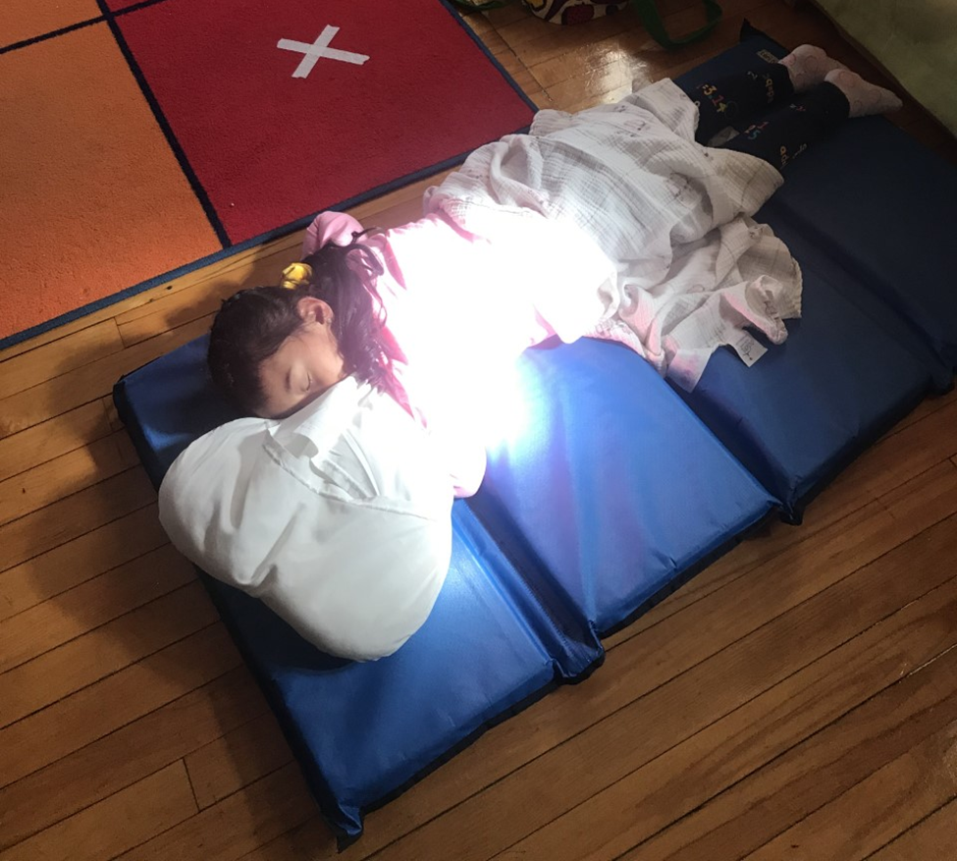
Rest time

Slide 17
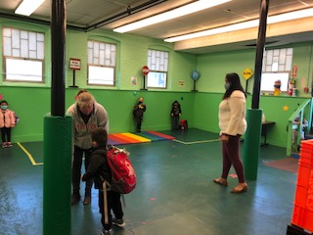
Dismissal

Slide 18
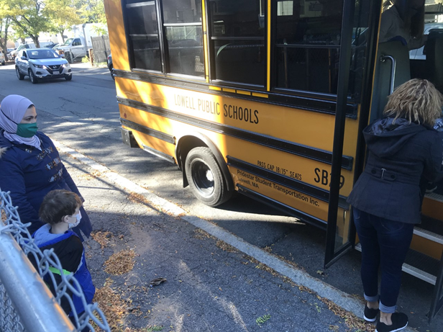
Going home….

Slide 19
What does your child need?
Backpack
Extra set of clothes that matches the season
Layers of clothes
Home - School Folder
Lunch or snacks from home (optional)
Water bottle (optional)
Diapers as needed (if applicable)

Slide 20
Forming family partnerships
ASQ opportunity to share expertise
Family conference twice per
Sharing ideas suggestion box
Teachers, Social Worker, & others available for meeting upon request
CFCE contact

Slide 21
Communication
Connect –Ed Calls
Email
Phone calls
Conferences
Class DoJo
Newsletters
Website

Slide 22
Visiting the School
CSA Open House - August 28, 2023 at 2:30 PM
Open House ALL – August 30, 2023 10:00 -11:00 AM or 1:00 -2:00 PM
Notes:
Subs and all visitors must sign in at the door and in the office. As you enter the building we ask that all sanitize their hands.

Slide 23
Open House and Family Coffee
September 28, 2023
10:00 -10:30 AM
OR
5:00 to 5:30 PM

Slide 24
School Site Council
School Site Councils - https://www.lowell.k12.ma.us/domain/2459
September 28, 2023
Schedules dates for
October
November
January – June based on those participating
Notes:
Looking for parent leaders

Slide 25
Parent Teacher Organization
Plan activities to promote a sense of community

Slide 26
Questions and Feedback
Notes:
Questions
Feedback
We want hear from you.
Please give suggestions for improvement

